Slide 1
Math Is No Longer A Four-letter Word: Student Experiences in Two Rigorous Non-Traditional Senior Year Math Courses
Erica Heinzman & Osvaldo Soto
http://bit.ly/TODOS2021
Notes:
1 min

Slide 2
Who we are
Dr. Erica Heinzman
Lecturer / Supervisor in Secondary Education
Dr. Osvaldo “Ovie” Soto
Director Discrete Math Project Collaborative (SDSU)
Director UC San Diego Math Project
Notes:
Intros: 2 min

Slide 3
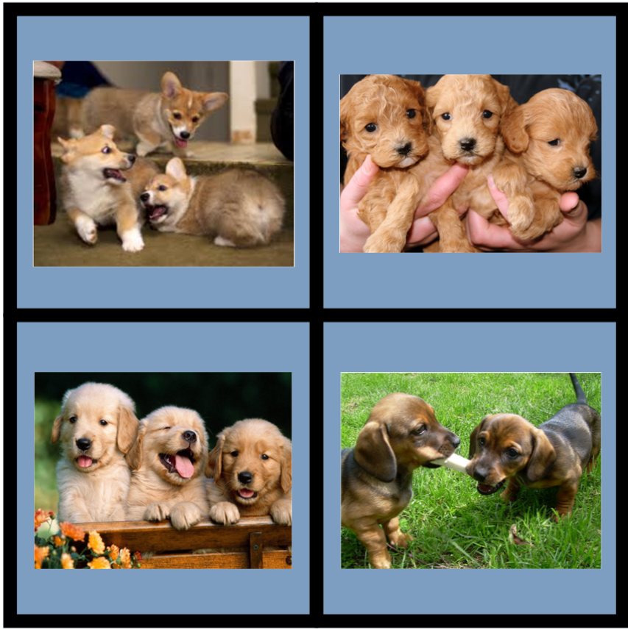
Which One Doesn’t Belong?
Notes:
Ovie
Credit: Aly Martinez, San Diego Unified School District
3 min

Slide 4
Overview
Why Math Pathways in High School
Case Study Findings of Two HS Math Pathway Courses
Introduction to Data Science (IDS)
Discrete Math Project Collaborative (DMPC)
Experience a Student Task from DMPC
Notes:
Ovie: 4 min (Ovie will interview Erica)

Slide 5
Why Math Pathways in High School
Notes:
6 min

Slide 6
High School math Pathways
High school mathematics largely unchanged for over a century
The predominant pathway algebra to calculus may fail to align with students’ interest
Students feel disconnected from math content
Limited access to four years of rigorous high school math courses, especially for Black, Indigenous, and Students of Color
Notes:
9 min

Slide 7
High School Math Pathways
Advocate for multiple HS Pathways
National Council of Teachers of Mathematics (Catalyzing Change)
Dana Center at UT Austin (Launch Years)
Just Equations (Branching Out)
Leading Recommendations
Encourage four years of rigorous HS math
Choose a pathway aligned to interests after a common experience
Incorporate equity-minded, research-based pedagogy
Notes:
Catalyzing Change Book
12 min

Slide 8
High School Math Pathways
A movement in multiple states
California, Georgia*, Ohio, Oregon, Virginia, Washington*
California Math Readiness Challenge Initiative (CMRCI)
Introduction to Data Science
Discrete Math Project Collaborative (DMPC)
*see Dana Center Launch Year’s Report
Notes:
Erica
14 min

Slide 9
2. Case Study Findings of Two HS Math Pathway Courses
Notes:
16 min (Ovie intro Erica)

Slide 10
Research Design
Mixed Methods
Observations
Students & Teacher Interviews
Survey
Two School Sites
Mediterranean High School (DMPC)
Sierra Madre High School (IDS)

Slide 11
Self-Determination Theory
Competence
Autonomy
Relatedness
Self-Efficacy
Agency
Sense of Belonging
(Ryan & Deci, 2000)

Slide 12
Findings
Experience Curiosity and Creative Freedom (Competence & Autonomy)
Feel Connected to a Community of Learners (Relatedness)
Use “Easy” in Complex Ways

Slide 13
Experience Curiosity and Creative Freedom (Competence & Autonomy)
“With regular math, it's the set equation and then you find your numbers. But with discrete, you have your numbers and then you find the equation....And that's why I like discrete a lot more than I like regular math”
Nia, Black DMPC Senior
“I like that.... I don't have to follow one simple rule, one way, I don't have to follow one way to get this answer, I like how I can just change it up a bit. I like it how I can use a histogram or maybe a bar graph or like tally or a XY plot [for] my answer”
Nolan, Latinx Junior

Slide 14
Feel Connected to a Community of Learners (Relatedness)
“Because other years, I've just been, okay, I got the answer.... I want to put it on a projector and be like, this is my work. I did it like this. Is there anybody else that relates to me?... I genuinely get happy... I have an urge to push myself and show it to other people. Whereas, I didn't like math before”
Jayden, Black DMPC Senior
“It's good because everyone in that class could help you because we're all at the same level. We're all beginners into IDS, so we're at the same level and we could really help each other.”
Catherine, Latinx IDS Junior

Slide 15
Use “Easy” in Complex Ways
“Oh, some of my friends are in AP stats…. in AP calc. And then I'm like, ‘Yeah, I'm in Discrete.’ And they're like, ‘Oh, why are you in that class? It's so easy. You guys don't do anything.’ But it's not that easy. You actually have to think more.”
Ava, Latinx DMPC Senior
“So my past math experiences were kind of bad. I hated math. You know, I was the type of person who would slack off on homework, fail my test. And but I feel like IDS for me, I started using coding and that was a lot easier for me to understand.”
Will, Asian IDS Senior

Slide 16
3. Experience a Student Task from DMPC
Notes:
30 min

Slide 17
Discrete Math Background
Students ill-prepared for college level math (CMRCI)
Can be used to advance mathematical ways of thinking (SMPs)
There’s more to love in math than just calculus
Support teachers in student-centered instruction
Notes:
Focus on engaging and shaping students’: interpreting, conjecturing, generalizing, justifying and meaning-making (for example)
The curriculum itself is a support for teachers

Slide 18
Discrete Math Design Principles
Goal: Advance students’ mathematical ways of thinking (CCSS Standards for Mathematical practice; Harel, 2008 a,b,c)
Problem-solving (PS) and productive struggle: keys to learning.
Through PS teachers engage students in: defining, interpreting, modeling, conjecturing, generalizing, and justifying.
Attending to Meaning: repeatedly experiencing phenomena before labels are introduced.

Slide 19
Units from Discrete Math
Combinatorial Game Theory
Graph Theory
Iteration/Recursion
Sequences and Series
Cryptography
Combinatorics

Slide 20
Discrete Math Professional Learning
Participants:
Experience mathematics and pedagogy as learners
On-going
Inquiry stance (learning about learners)
Community of collaborators

Slide 21
Play the Game
Open the Jamboard to the play game.
Pause the video… rules are on the Jamboard (several versions for fun).
*You may want to find a friend to play with … or not.

Slide 22
Reflection
Did you or your friend invent any terms?
Notice any patterns?
Raise any conjectures?
Make any generalizations?
Did you prove any conjectures?
What would constitute a proof?

Slide 23
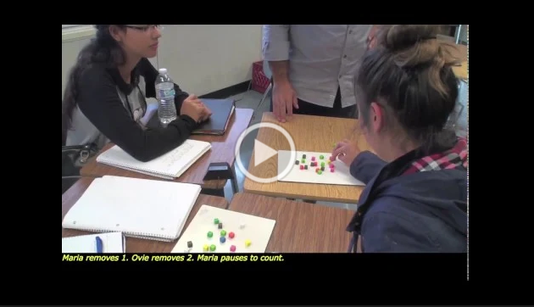
Classroom VIDeo
Background: Multilingual learners, middle/end of the problem-solving process
The video has a strong hint, but no spoiler.
Reread the question from the previous slide.
Watch, pause, reflect, rewatch the video here.
What strikes you?

Slide 24
Discrete Math Design Principles
Goal: Advance students’ mathematical ways of thinking (CCSS Standards for Mathematical practice; Harel, 2008 a,b,c)
Problem-solving (PS) and productive struggle: keys to learning.
Through PS teachers engage students in: defining, interpreting, modeling, conjecturing, generalizing, and justifying.
Attending to Meaning: repeatedly experiencing phenomena before labels are introduced.

Slide 25
Stay in Touch
Dr. Erica Heinzman
(eheinzman@ucsd.edu)
@eheinzman1
Dr. Osvaldo Soto
(osoto@ucsd.edu)

