Slide 1
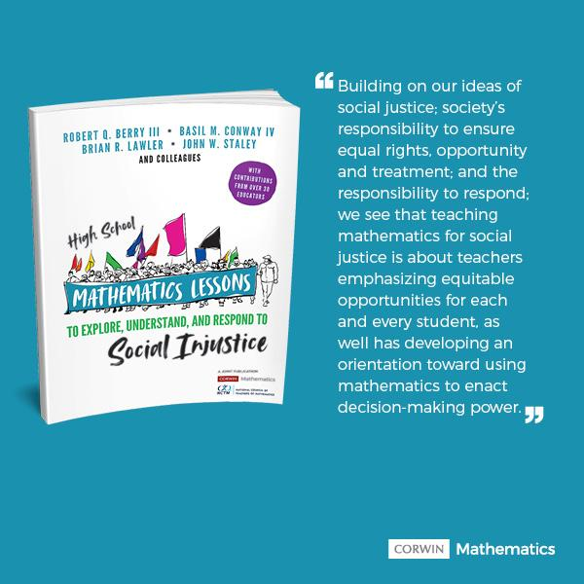
High School Mathematics Lesson to Explore, Understand, and Respond to Social Injustice
slides available
bit.ly/TODOSjune22
June 22, 2021
Twitter: @SJMathematics
Facebook: HS Math Lessons to Explore Injustice
John W. Staley @jstaley06 johnstaley64@gmail.com
Brian R. Lawler @blaw0013 brian.lawler@kennesaw.edu
Notes:
JOHN
1. Intro/Framework [8 min]
2. Lesson 1 [15 min]
3. Debrief and highlight preparing for the lessons (About SJ, What Matters. ) [6 min]
4. Lesson 2 [15 min]
5. Debrief and highlight (with SJ) [6 min]
6. Q & A (For SJ) [10 min]

Slide 2

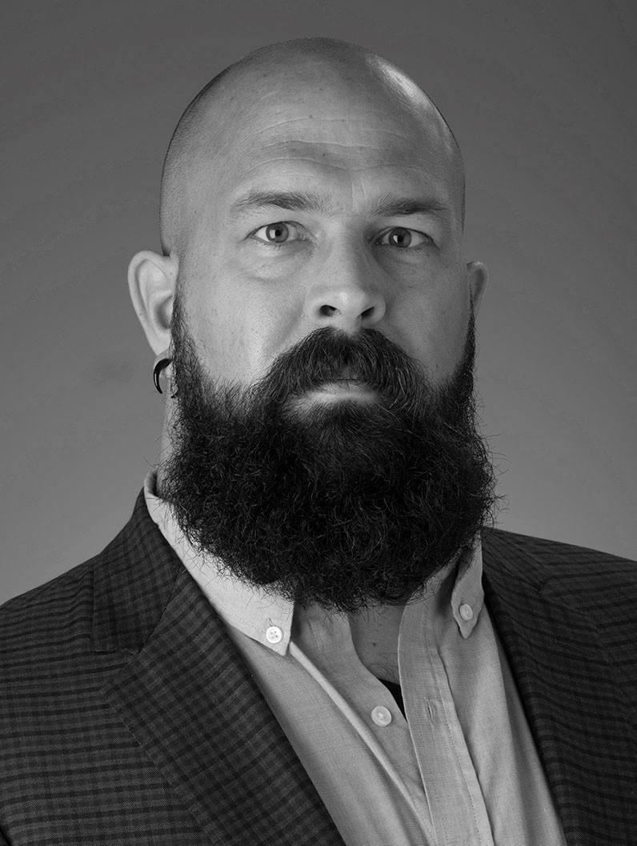
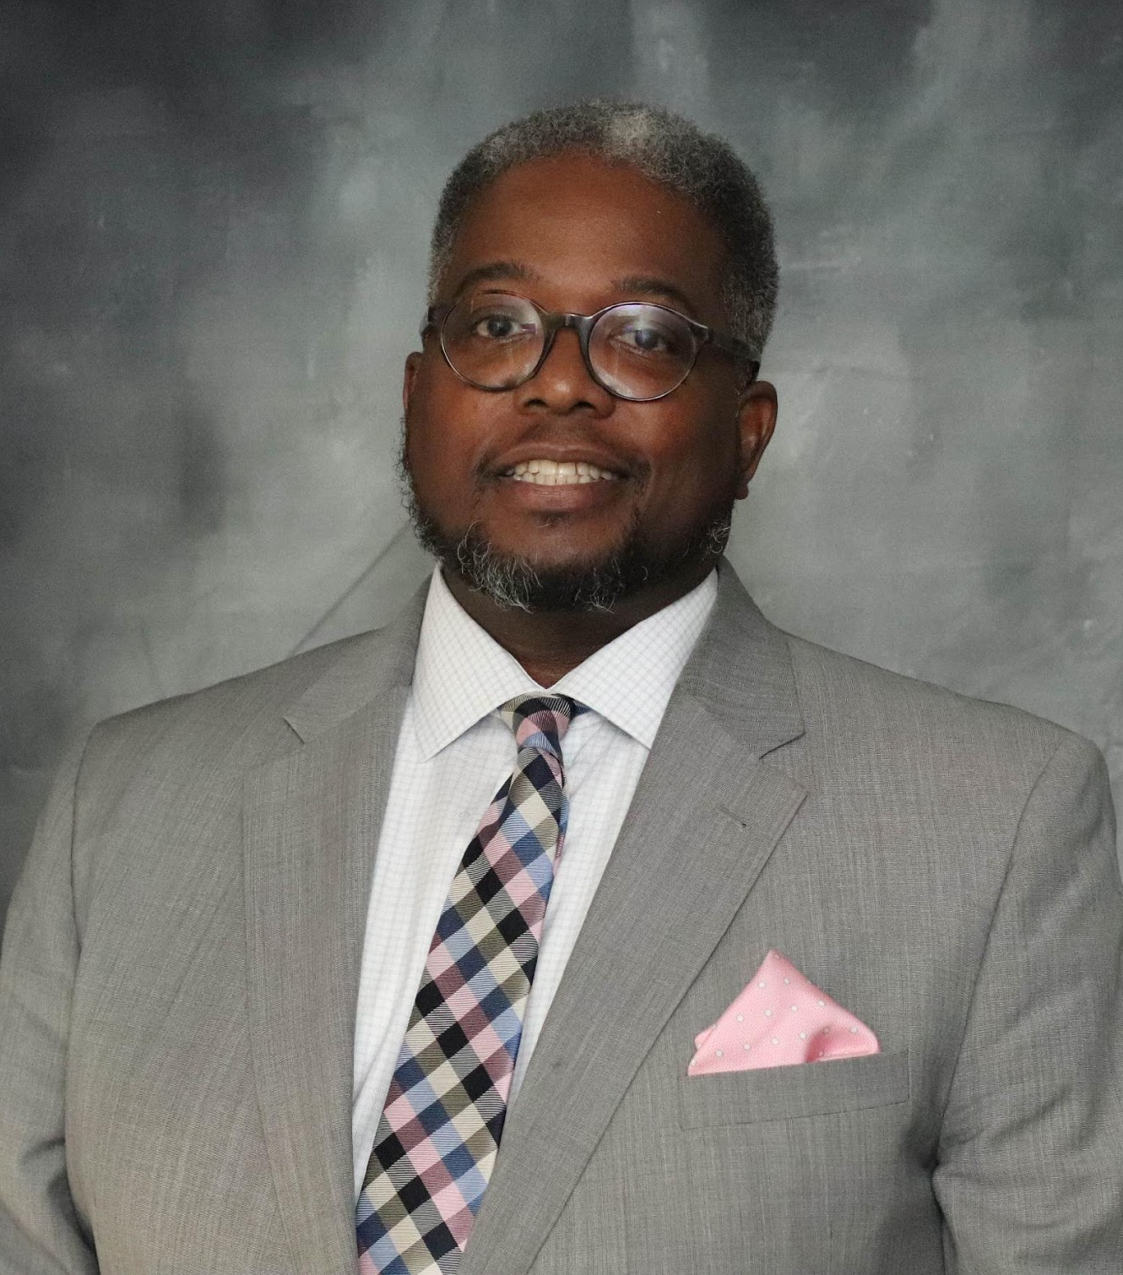
Who is in the room?
Role & Grade Band
Preservice Teacher
Teachers
Teacher Leaders
Coaches/Facilitators
District Leaders
School Administrators
University and College Faculty
Professional Development Providers
Other
This Photo by Unknown Author is licensed under CC BY-SA
Notes:
JOHN

Slide 3



What comes to mind when you think about social justice in the mathematics classroom?
Notes:
JOHN

Slide 4
Teaching Math for Social Justice (TMSJ) is much more than the lessons teachers might implement in their classrooms. It is about the relationships they build with and among students; the teaching practices that help them do that; and the goals to develop positive social, cultural, and mathematics identities— as authors, actors, and doers. (p. 23)
Notes:
JOHN

Slide 5
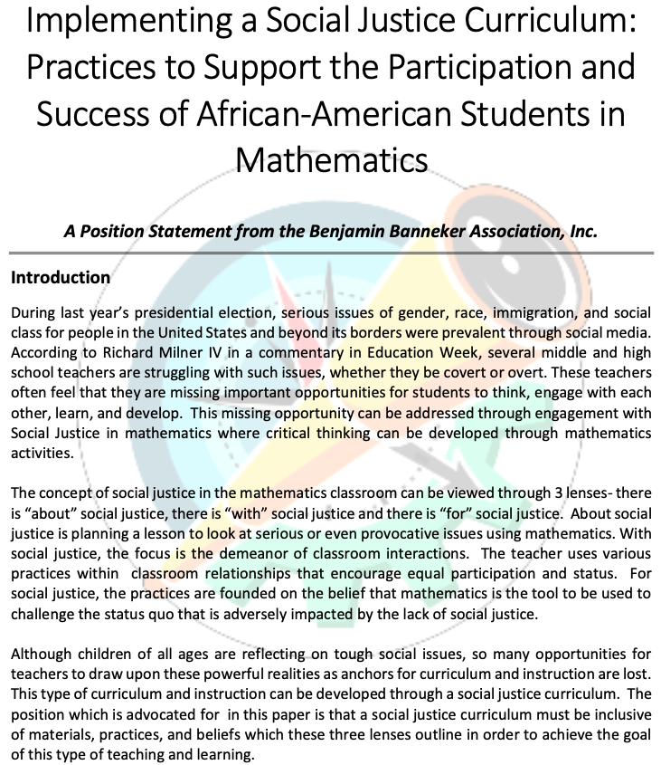
Our time together
About Social Justice: What school or community issue of social injustice might our students be interested to better understand and act upon?
With Social Justice: How do I create a learning environment that supports social justice?
For Social Justice: How can I prepare and empower my students to use mathematics as a tool to challenge the status quo?
Visit bbamath.org
Notes:
JOHN

Slide 6


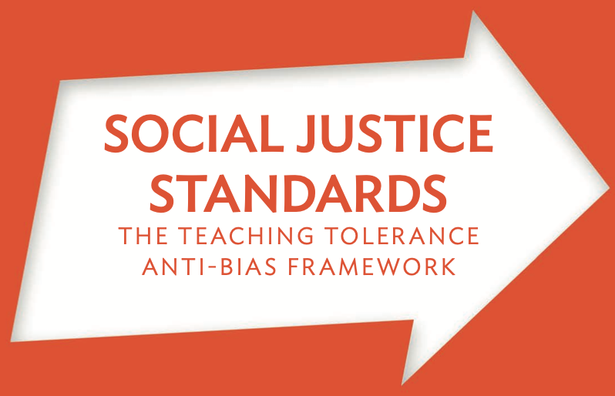
Social Justice considers...
...the contributions and rights of each and every person in society (UN, 2006)
Access
Participation
Empowerment
Human rights
...how we develop students’ deeper understanding and awareness (Learning for Justice, 2017)
Identity
Diversity
Justice
Action
Notes:
JOHN
social justice means considering the contributions and rights of each and every person in society across four ideas (United Nations, 2006):
Access: Ensuring access to and the fair distribution of human and material resources in society.
Participation: Creating equitable opportunities for people to access information to be fully participatory in decisions that affect their and others’ lives.
Empowerment: Supporting people’s sense of agency in taking advantage of opportunities society affords as well as working toward eliminating all forms of oppression.
Human Rights: Acknowledging the rights inherent to each and every human being, regardless of race, sex, gender, nationality, ethnicity, language, religion, or any other status. Human rights include the right to life and liberty, freedom from slavery and torture, freedom of opinion and expression, the right to work and education, and many more.
Learning for Justice, formerly Teaching for Tolerance, names four dimensions of a social justice pedagogy:
Identity – how we view ourselves; mathematically and socially
Diversity – how we view others and their perspectives (respecting others, respectful enough to acknowledging differences, treat them with dignity and tolerance)
Justice – how we view fairness and unfairness, unequal power relations, impact of bias (BBA moving from teaching “about” but “for” SJ)
Action – Moving towards and taking steps towards making a just and equitable society.

Slide 7
Teaching mathematics for social justice helps to...
build an informed society,
connect mathematics with students’ cultural and community histories,
empower students to confront and solve real-world challenges they face,
and
help students learn to value mathematics as a tool for social change.
Notes:
JOHN

Slide 8
Teaching mathematics for social justice helps to...
...Broaden the Purposes of Learning Mathematics
Develop deep mathematical understanding as confident and capable learners (Elem, Middle)
Expand professional opportunities (High)
Understand and critique the world (all)
Experience the wonder, joy, and beauty of mathematics (all)
(NCTM Catalyzing Change Series)
Notes:
JOHN

Slide 9
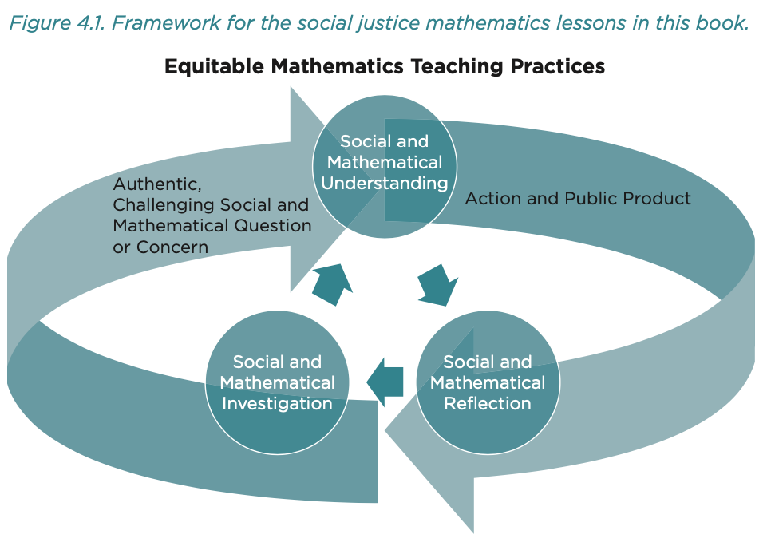
Social Justice Mathematics Lesson Framework
Elements of SJML Framework
Equitable Mathematics Teaching Practices
Authentic, Challenging Social and Mathematical Question or Concern
Social and Mathematical Understanding
Social and Mathematical Investigation
Social and Mathematical Reflection
Action and Public Product
Notes:
BRIAN
Foundation (Getting your classroom ready; affirming students’ personal identities and building positive mathematical identities)
the relationships they build with and among students (questions come from the classroom, come from larger world issues non-local, what do we do about injustice?)
Elements 3, 4, and 5 are largely emphasized during the lesson. Math then Social or Social then Math?

Slide 10
Do Postal Codes
Predict Test Scores?
Notes:
BRIAN – [15 min] Lesson 7.4
Look at EdGap; draw out each of the 6 steps (slide 9)

Slide 11
Do Postal Codes Predict Test Scores?
If we took all the high school students in the whole city, do you think people who carry a shoulder bag would have higher SAT scores than people who carry a backpack?
How about people born outside our state compared to inside?
We assume intellectual ability is equally distributed across any subgroup of people.
EdGap.org
Notes:
BRIAN
BRILLIANCE

Slide 12
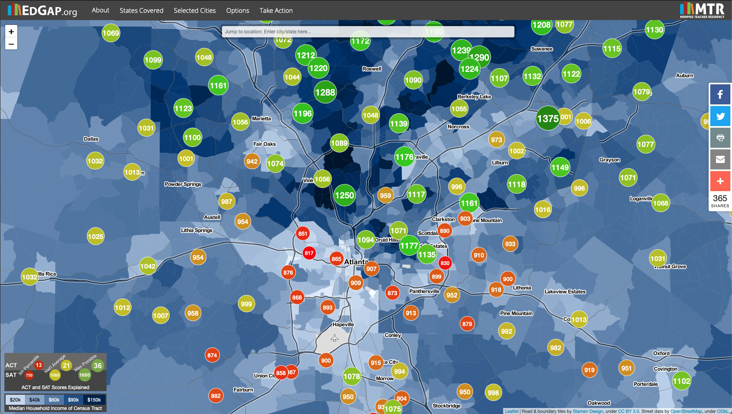
Do Postal Codes Predict Test Scores?
Notes:
BRIAN
What do you notice?
What do you wonder?

Slide 13
Do Postal Codes Predict Test Scores?
We assume intellectual ability is equally distributed across any subgroup of people.
School Name | Postal Code | SAT Score | Median Household Income | Median Age | Geographic Mobility | ?
Decatur HS | 30030 | 1177 | $82,131 | 38.1 | 18.2%
Towers HS | 30032 | 830 | $32,358 | 36.5 | 24.5%
Maynard Jackson HS | 30316 | 907 | $60,700 | 36.4 | 15.5%
DeKalb School of Arts | 30002 | 1135 | $34,938 | 43.6 | 20.5%
EdGap.org
Notes:
BRIAN

Slide 14
Do Postal Codes Predict Test Scores?
Deep & Meaningful Understanding of Mathematics | Math Standards
Scatterplots Trends Correlation vs. Causation Correlation Coefficient | VSD.4 – Scatterplots can reveal patterns, trends, clusters, and gaps that are useful in analyzing the association between two contextual variables. VSD.5 – Analyze association between two quantitative variables with statistical procedures, such as the sum of squared deviations in fitting a linear model, analyzing residuals for patterns, generating a least-squares regression line and finding a correlation coefficient, and differentiating between correlation and causation.
Deep & Meaningful Understanding of a Social Context | Social Justice Standards
Income inequality Opportunity inequality | Diversity 8 – I respectfully express curiosity about the history and lived experiences of others and exchange ideas and beliefs in an open- minded way. Action 19 – I stand up to exclusion, prejudice and discrimination, even when it’s not popular or easy or when no one else does.
Action and/or Public Product
Prepare a letter or give a presentation to a local government agency, such as a city council and school board. Identify the concern and support with data. Provide a clear explanation of the data along with your analysis and examination of why the patterns emerge.
Notes:
BRIAN
Equitable Mathematics Teaching Practices
Authentic, Challenging Social and Mathematical Question or Concern
Social and Mathematical Understanding
Social and Mathematical Investigation
Social and Mathematical Reflection
Action and Public Product

Slide 15
About social justice:
planning a lesson to look at serious or even provocative issues using mathematics
What school or community issue of social injustice might our students be interested to better understand and act upon?
Notes:
BRIAN
What initial mathematical potential do you see in this topic?
What SJ issue?

Slide 16
What Matters
Content
When
Mathematics
Unit, Course, Special Opportunity
Beginning, Middle, End
Instructional Aim
Content Concepts
Practices
Math Content Standards
Math Practices
Reteaching & activating prior knowledge
Continued learning & practice
Preview future course content
Social Justice
Issue
Standards and Outcomes
Context
Purpose
Audience
Allies
Timing
How
Mathematics Tasks
Three-Act Tasks
Project-based Learning
Notes:
JOHN
QUICK

Slide 17
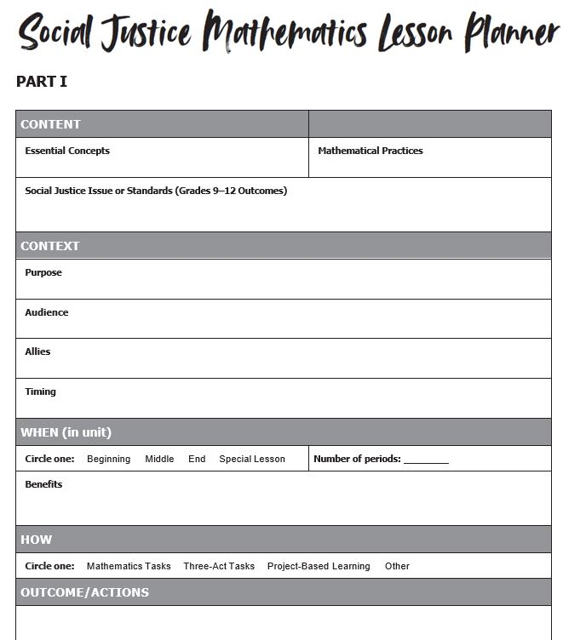
What Matters
Unpacking What Matters
overarching goals for the class
alignment to content standards
connections to students’ lived experiences
possible biases and alternative perspectives of self and others
how to facilitate the learning and conversations to allow students’ voices to be shared and heard
Notes:
JOHN
As you think about What Matters here are five things for you to consider:
overarching goals for the class,
alignment to content standards,
connections to students’ lived experiences,
possible biases and alternative perspectives of self and others, and
how to facilitate the learning and conversations to allow students’ voices to be shared and heard.

Slide 18
What Matters: Context
What is my purpose for including the social justice topic as part of the lesson?
How does the SJML contribute to building students’ identity and agency?
Who is on my team of allies ready to support me?
What do I know about how this topic intersects with local concerns and interests? How might this topic be received in my local setting?
Notes:
JOHN
Now let’s take a closer look at Context
What is my purpose for including the social justice topic as part of the lesson?
What do I know about how this topic intersects with local concerns and interests? How might this topic be received in my local setting?
Who is on my team of allies ready to support me?
How does the SJML contribute to building students’ identity and agency?

Slide 19
Do Just Some Students Take Honors Courses?
Notes:
BRIAN – [15 min] Lesson 5.2

Slide 20
Do Just Some Students Take Honors Courses?
We assume intellectual ability is equally distributed across any subgroup of people.
What are the different options ninth grade students have for math? for ELA?
Who decides what class you can take? How do they decide?
What classes are your friends taking?
Would you say the racial makeup of your classes is the same as the city? the school?
Do you think there is a difference between the number of Black students enrolled in the school and those enrolled in honors classes?
Lee Stiff introduces analyzing data patterns (15:10-20:10)
vimeo.com/11201239
Notes:
BRIAN

Slide 21
Do Just Some Students Take Honors Courses?
From Race and Teacher Evaluations as Predictors of Algebra Placement bit.ly/Race_Alg (Faulkner, Stiff, Marshall, Nietfeld, & Crossland, 2014)
Odds of a Black student being placed in advanced courses in fifth grade | 0.68
Odds of a white student being placed in advanced courses in fifth grade | 1.48
Odds of a Black student being placed in advanced courses in fifth grade who was labeled high performing | 1.93
Odds of a white student being placed in advanced courses in fifth grade who was labeled high performing | 3.05
What do these number mean? What would be an appropriate unit label?
How are odds different from probability statements?
At our school, there are 500 students in grade 9. Our demographic is 45% Black and 55% white. Use the rates from this research to determine how many students should be in honors classes.
Notes:
BRIAN

Slide 22
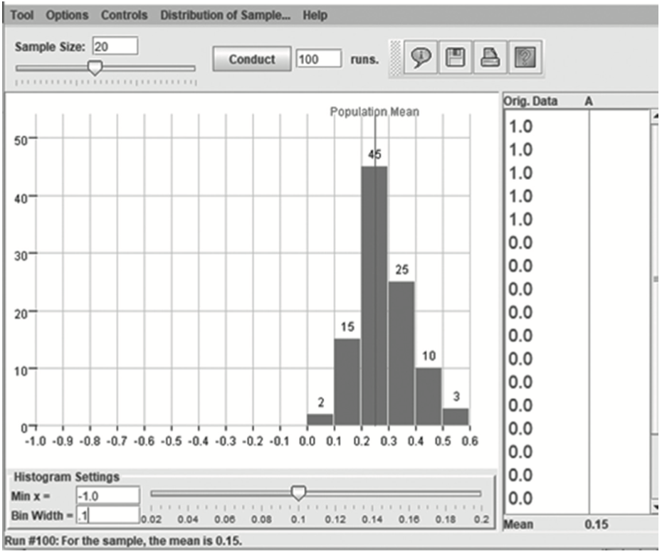
Do Just Some Students Take Honors Courses?
Do you think there is a difference between the number of Black students enrolled in the school and those enrolled in honors classes?
Students can design a simulation that models one Honors or AP math course.
model the racial demographics
draw cards (with replacement) to create a sample class of 20
repeat 100 times
create a histogram
determine the proportion of results falling between two values centered at the mean
NCTM Position Statement
bit.ly/2ksnLFb
Notes:
BRIAN
25% Black, 75% white – 100 times modeled a class of 20
95% confident the class is between 10% and 40% Black
used NCTM Core Math Tools

Slide 23
Do Just Some Students Take Honors Courses?
NCTM Position
All students should have the opportunity to receive high-quality mathematics instruction, learn challenging grade-level content, and receive the support necessary to be successful. Much of what has been typically referred to as the “achievement gap” in mathematics is a function of differential instructional opportunities. Differential access to high-quality teachers, instructional opportunities to learn high-quality mathematics, opportunities to learn grade-level mathematics content, and high expectations for mathematics achievement are the main contributors to differential learning outcomes among individuals and groups of students.
bit.ly/2ksnLFb
Notes:
BRIAN
February, 2012

Slide 24
Do Just Some Students Take Honors Courses?
Deep & Meaningful Understanding of Mathematics | Math Standards
odds, ratio, rate design of a statistical study margin of error | N.2 – Quantitative reasoning includes, and mathematical modeling requires, attention to units of measurement. SI.6 – The sampling distribution of a sample statistic formed from repeated samples for a given sample size drawn from a population can be used to identify typical behavior for that statistic. Examining several such sampling distributions leads to estimating a set of plausible values for the population parameter, using margin of error as a measure that describes the sampling variability.
Deep & Meaningful Understanding of a Social Context | Social Justice Standards
tracking implicit bias colorblindness | Justice 12 – I can recognize, describe and distinguish unfairness and injustice at different levels of society. Justice 13 – I can explain the short and long-term impact of biased words and behaviors and unjust practices, laws and institutions that limit the rights and freedoms of people based on their identity groups.
Action and/or Public Product
Speak with the principal, superintendent, PTO leaders, or other stakeholders about how students are placed into math courses. Set goals and determine strategies and with these leaders to reduce the potential systematic misplacement of students by race and/or gender.
Notes:
BRIAN

Slide 25



With social justice:
the demeanor of classroom interactions, where the teacher uses various instructional practices that encourage equal participation and status
How might we design your classroom environment to infuse social justice?
Notes:
BRIAN

Slide 26
Mathematical Identity and Agency
Mathematical Identity – the dispositions and deeply held beliefs that students develop about their ability to participate and perform effectively in mathematical contexts and to use mathematics in powerful ways across the contexts of their lives.
(Impact of Identity, p. 14)
Mathematical Agency – the expression of one’s identity. (Murrell, 2007)
Engage in productive struggle.
Take risks to make their mathematical thinking visible.
Understand that learning results when they successfully leverage an approach that works for them.
(Catalyzing Change, p. 28)
Notes:
JOHN

Slide 27
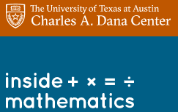
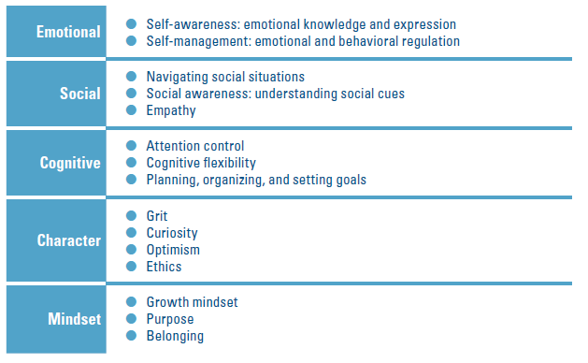

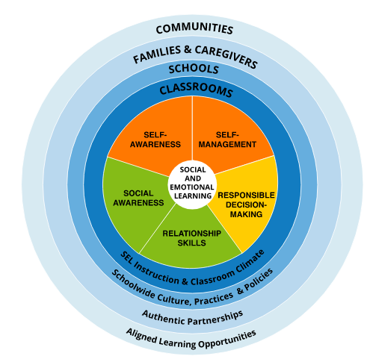
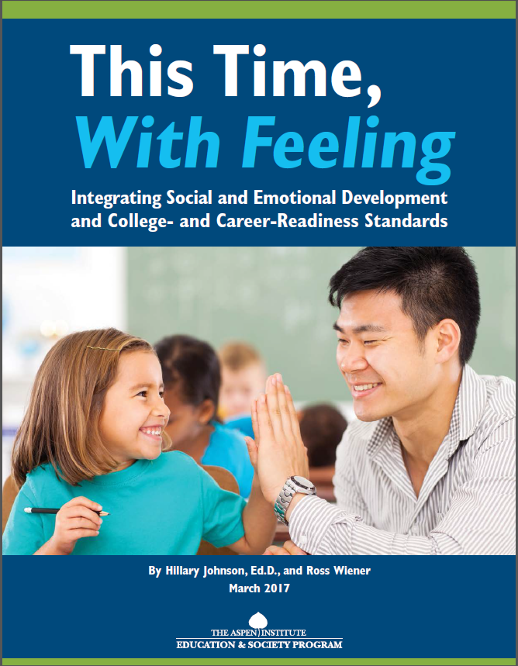
Social, Emotional, Academic Development
5 Domains and Attributes
SEL and Mathematics
https://casel.org
This Time, With Feeling: Integrating Social and Emotional Development and College- and Career-Readiness Standards
CASEL-SEL-Framework-11.2020.pdf
Notes:
JOHN – SEL not just for some students
Collaborative for Academic, Social, and Emotional Learning
Self-awareness: Know your strengths and limitations, with a well-grounded sense of confidence, optimism, and a “growth mindset.”
Self-management: Effectively manage stress, control impulses, and motivate yourself to set and achieve goals.
Social awareness: Understand the perspectives of others and empathize with them, including those from diverse backgrounds and cultures.
Relationship skills: Communicate clearly, listen well, cooperate with others, resist inappropriate social pressure, negotiate conflict constructively, and seek and offer help when needed.
Responsible decision-making: Make constructive choices about personal behavior and social interactions based on ethical standards, safety, and social norms.

Slide 28
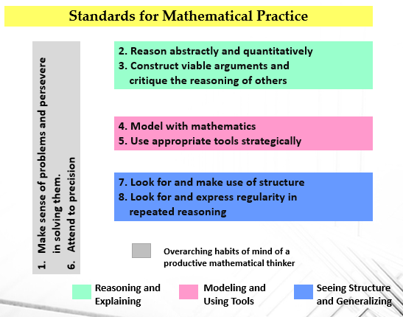
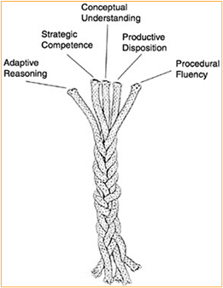
Mathematically proficient students…
Strands for Mathematical Proficiency
Notes:
JOHN
http://www.corestandards.org/Math/Practice/
https://www.nap.edu/catalog/9822/adding-it-up-helping-children-learn-mathematics
NCTM Process Standards

Slide 29
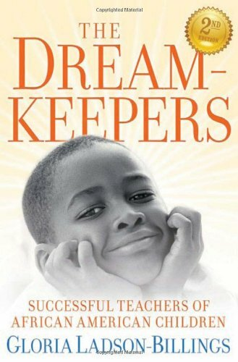
Culturally Relevant Teaching/Pedagogy
“Culturally relevant teaching requires that students maintain some cultural integrity as well as academic excellence.” (Ladson-Billings, p. 160, 1995)
Culturally relevant pedagogy rests on three criteria or propositions:
Students must experience academic success;
Students must develop and/or maintain cultural competence; and
Students must develop a critical consciousness through which they challenge the status quo of the current social order.
(But that’s just good teaching! The Case for Culturally Relevant Teaching. Ladson-Billings, 1995)
Notes:
JOHN
Culturally relevant teachers utilize students’ culture as a vehicle for learning. P. 161, 1995
3 Tips to Make Any Lesson More Culturally Responsive https://www.cultofpedagogy.com/culturally-responsive-teaching-strategies
I’m Here for the Hard Re-Set: Post Pandemic Pedagogy to Preserve Our Culture. Ladson-Billings, 2021. Equity & Excellence in Education Vol 54.
The next element of culturally relevant pedagogy is cultural competence. This is perhaps the most misunderstood aspect of the theory. Far too many teachers believe if they make some effort to represent diverse cultures, they are exhibiting cultural competence. Cultural competence means that students are secure in their knowledge and understanding of their own culture—language, traditions, histories, culture, and so forth, AND are developing fluency and facility in at least one other culture.… In the case of minoritized students that other culture is typically the mainstream culture. It should be noted that White students are not exempt from developing cultural competence. All students will be thrust into a diverse, multicultural world where they will need to understand the culture of those different from themselves.

Slide 30
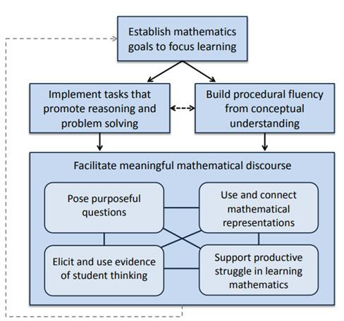
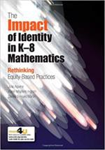
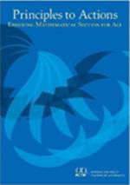
Equitable Teaching Practices
Going deep with mathematics
Leveraging multiple mathematical competencies
Affirming mathematics learners’ identities
Challenging spaces of marginality
Drawing on multiple resources of knowledge
Aguirre, Mayfield‐Ingram, & Martin. (2013). The Impact of Identity
in K‐8 Mathematics: Rethinking Equity Based Practices. NCTM.
NCTM. (2014). Principles to Actions: Ensuring Mathematical Success for All. NCTM.
Notes:
JOHN

Slide 31
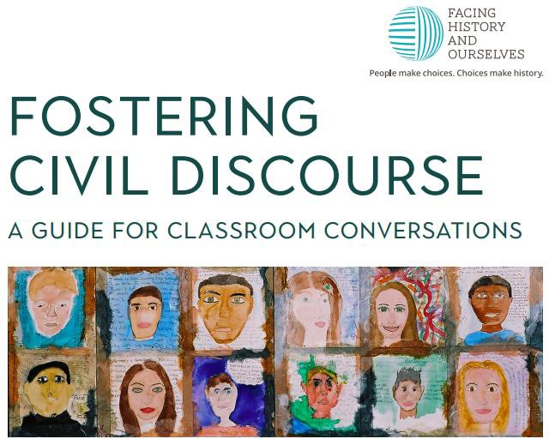
The Role of Discourse
Student Engagement
Valuing Voice
Supporting all Students
  Multilingual Learners
  Students with Special Needs
Emotional or Sensitive Conversations
https://www.facinghistory.org/books-borrowing/fostering-civil-discourse-how-do-we-talk-about-issues-matter
Prep Work
Start with Yourself
Develop a Reflective Classroom Community
Create a Classroom Contract
Provide Opportunities for Student Reflection
Establish a Safe Space for Sensitive Topics
Implement Effective Teaching Strategies
Notes:
JOHN
https://www.facinghistory.org/books-borrowing/fostering-civil-discourse-how-do-we-talk-about-issues-matter

Slide 32
For social justice:
practices founded on the belief that mathematics is the tool to be used to challenge the status quo, one that is adversely impacted by the lack of social justice
What will you do to deepen your understanding of teaching mathematics for social justice?
Notes:
BRIAN - What work do I need to do to help my students use math to push back on the status quo?

Slide 33
Mathematics lessons that focus on understanding social and racial injustices are an important piece of the broader struggle for justice. However, if we as teachers simply take an activity and implement it in our classrooms without first doing the self-reflective work to understand how we all are impacted by racial trauma, then we may not be able to engage with the lesson in ways that are positively impactful for students. It takes time to do the hard self-reflective work of understanding how we are all impacted by racial trauma and then take steps to heal from it (Menakem, 2014) – time that our communities need mathematics teachers to take.
The Mo(ve)ment to Prioritize Antiracist Mathematics, TODOS https://www.todos-math.org/
Notes:
BRIAN

Slide 34
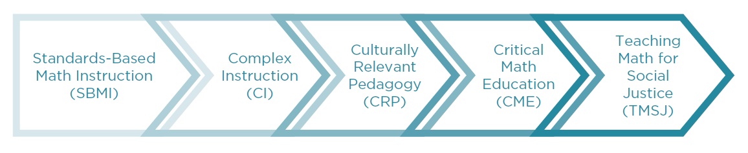


Teaching Math for Social Justice (TMSJ)
Your Level of Familiarity
Rank yourself (Scale: 1=new → 5=can teach)
Notes:
BRIAN

Slide 35
Status differences may result in students having less access to interaction
Create multidimensional classroom, where every student is recognized to have mathematical ability
Cohen & Lotan and Horn
Students’ own cultural practices, experiences, and assets
Academic achievement, cultural competence, and critical consciousness
Ladson-Billings
Youth play a critical role in the solution to injustice.
Gutstein, Moses, Gillen
TMSJ has two goals: freedom from oppression through the development of mathematical literacy, and freedom to act upon and impact the world through personal and social transformation.
Learning for understanding
Discourse-rich learning environment marked by conjecture, reasoning, & justification
Each and every student learns meaningful mathematics
Principles to Action
Shift in the power dynamic between student and teacher, shifting the authority for knowledge to the social context of the classroom community rather than the teacher.
Learning can emerge from a problem-posing pedagogy, designed around the ideas, hopes, doubts, fears, and questions that emerge in a person’s relationship with the world—“generative themes” (Freire)
Freire, Gutstein, Wager & Stinson
Notes:
BRIAN
Standards-Based Mathematics Instruction
Learning for understanding is emphasized over fluency with algorithms and facts.
Understanding develops in a discourse-rich learning environment marked by conjecture, reasoning, and justification.
Teachers are responsible for ensuring each and every student learns meaningful mathematics.
Complex Instruction
Inequities of the larger society are replicated in small group work, creating status differences.
Status differences ensure that some students have less access to interaction, thus fewer opportunities to learn (Expectations States Theory).
The teacher can impact this by creating a multidimensional classroom, raising classmates’ expectations for contributions from each and every student.
Culturally Relevant Pedagogy
Curriculum and instruction must draw upon students’ own cultural practices, experiences, and assets.
The pedagogy has three aims: academic achievement, cultural competence, and critical consciousness.
Critical Mathematics Education
shift in the power dynamic between student and teacher, shifting the authority for knowledge to the social context of the classroom community rather than the teacher.
students viewed as both “an actor and author of history” as opposed to containers to receive knowledge deposits from the teacher.
Learning can emerge from a problem-posing pedagogy, designed around the ideas, hopes, doubts, fears, and questions that emerge in a person’s relationship with the world—what Freire refers to as “generative themes”
TMSJ must be rooted in viewing students as an important part of the solution to injustice (Gutstein, 2006, 2018; Cobb & Moses 20xx; Gillen, 201x)

Slide 36

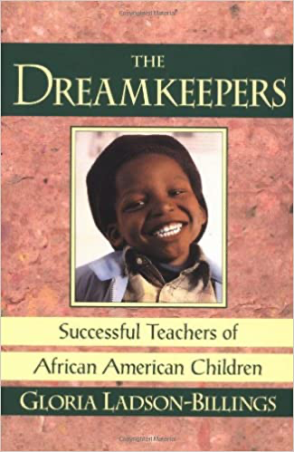
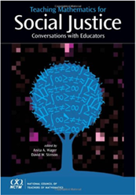
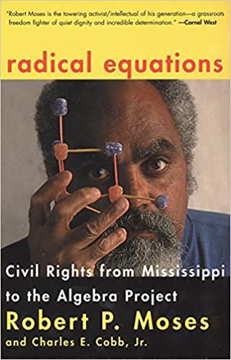
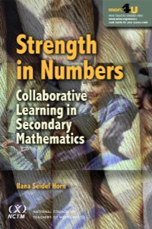
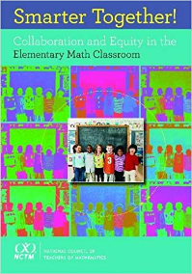
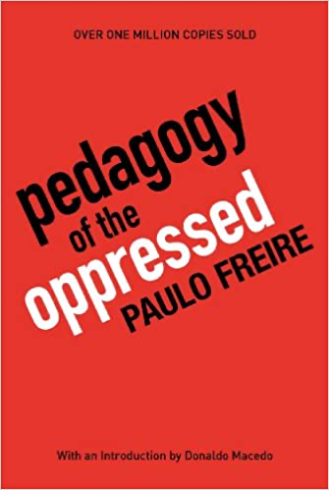
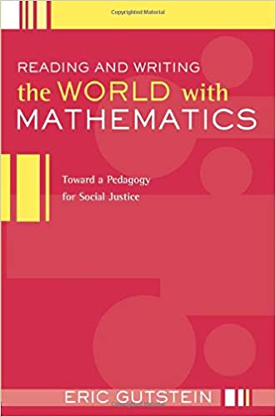

Notes:
BRIAN – What will you pick up next?

Slide 37
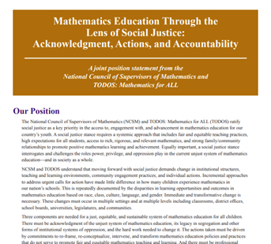
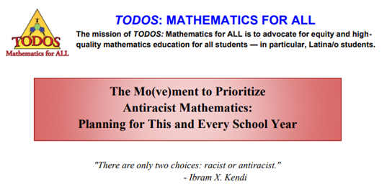
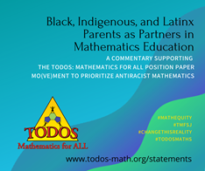
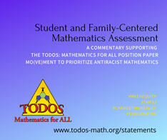
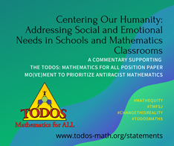
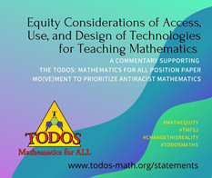
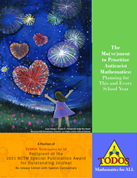
https://www.mathedleadership.org/docs/resources/positionpapers/NCSMPositionPaper16.pdf
http://bbamath.org/wp-content/uploads/2017/11/BBA-Social-Justice-Position-Paper_Final.pdf
https://www.todos-math.org/statements
Notes:
JOHN

Slide 38
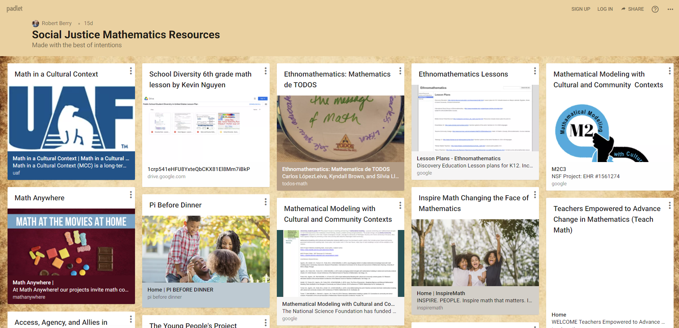
https://padlet.com/rqb3e/sjmathresources
Notes:
JOHN

Slide 39
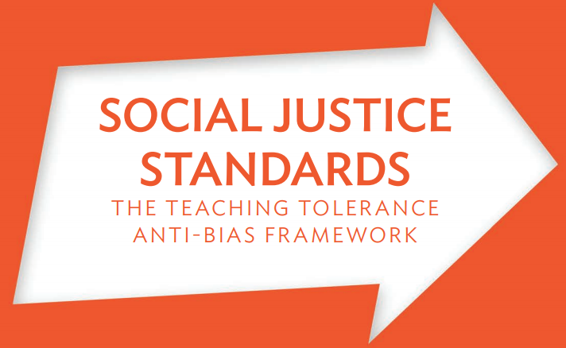
Creating Your Own Lessons
Learn about relevant social injustices
Identify the mathematics
Establish your goals
Determine how you will assess your goals
Create a social justice question for the lesson
Design the student resources for the investigation
Plan for reflection and action
www.tolerance.org/sites/default/files/2017-06/TT_Social_Justice_Standards_0.pdf
Notes:
JOHN – now you’re ready, we found the SJ Standards to help us
and Q&A
(1) Dive into communities of students and get involved.
(3) Set both mathematics and social justice goals for your lesson, Element 3 of the SJML framework;

Slide 40
What are you going to do to Change the Narrative?
“The choices we make in the first few weeks of the new school year will send a message to the students, families, and the communities with whom we work. Those choices should make clear that our students’ well-being and sense of belonging are our priority.”
TODOS: Student and Family-Centered Mathematics Assessment
Notes:
JOHN

Slide 41
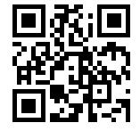
We value your input. Please take a few minutes to provide TODOS with feedback on each of the sessions you attend. Answering will allow us to improve our conferences moving forward.
https://bit.ly/3uYIpuJ
Individual Session Feedback
Notes:
JOHN

Slide 42
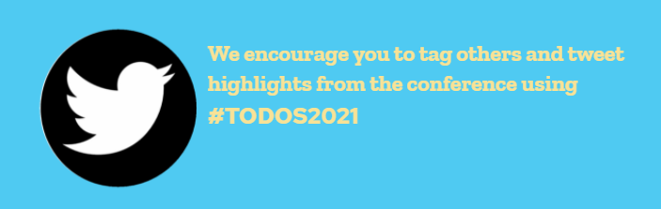
Notes:
JOHN

Slide 43
High School Mathematics Lesson to Explore, Understand, and Respond to Social Injustice
slides available
bit.ly/TODOSjune22
June 22, 2021
Twitter: @SJMathematics
Facebook: HS Math Lessons to Explore Injustice
John W. Staley @jstaley06 johnstaley64@gmail.com
Brian R. Lawler @blaw0013 brian.lawler@kennesaw.edu

